Slide 1
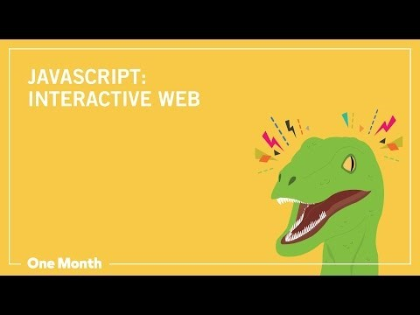
Before We Get Started, Let’s Learn Why Javascript is a Nice Language

Slide 2
Writing a Javascript Function: Practice
Using repl.it, we are going to write our first Javascript Function!
The following exercises will help you realize the type of logic that is needed in most coding which is Our 4CoreConcepts (Variables, Functions, Conditionals, and Loops)
Remember: We are going to use the command console.log() to ask the computer to print out our answers and see if it is correct.
Example: console.log(addTwoNumbers(1,2));
This command uses console.log to print out the result of 1 and 2 when inputted into the function addTwoNumbers

Slide 3
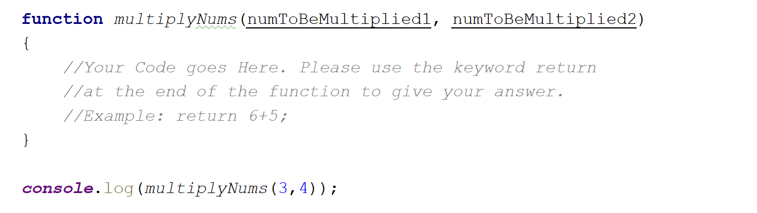
Exercise #1: Warm-Up with Functions
Write a Javascript function that will multiply the two numbers given and return them. Look at the following function for guidance.

Slide 4
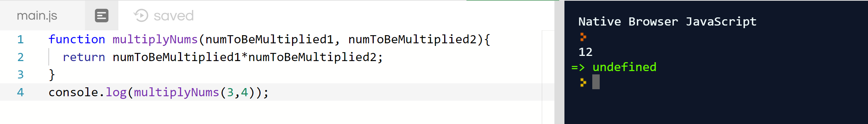
Answer for Exercise #1: Functions
Remember that there are more than one ways to code a solution to any problem. Here is one:
Tip: remember that in Javascript, operations such as multiplication (*), division (/), addition (+), and subtraction (-) are modeled as so.

Slide 5
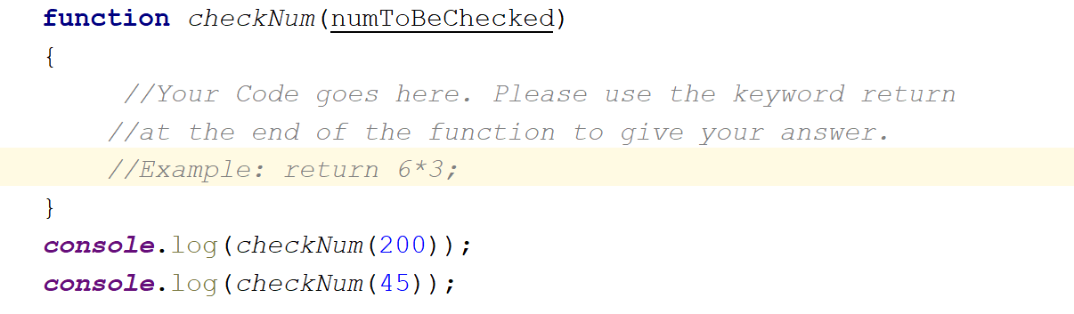
Javascript Exercise #2: Functions and Conditionals
Write a program to check if a number given is between 0 and 100. If it is, add 5 to the number and return the value. Otherwise, return 0. Look at the following function for guidance.
Tip: Remember that you can make two statements at a time with symbols that mean and (&&), or (||) , not(!), equal(==), not equal (!=) , greater than(>) or less than (<).
Example: if (randomVar<34 && randomVar!=3) means if randomVar is less than 34 and does not equal 3.

Slide 6
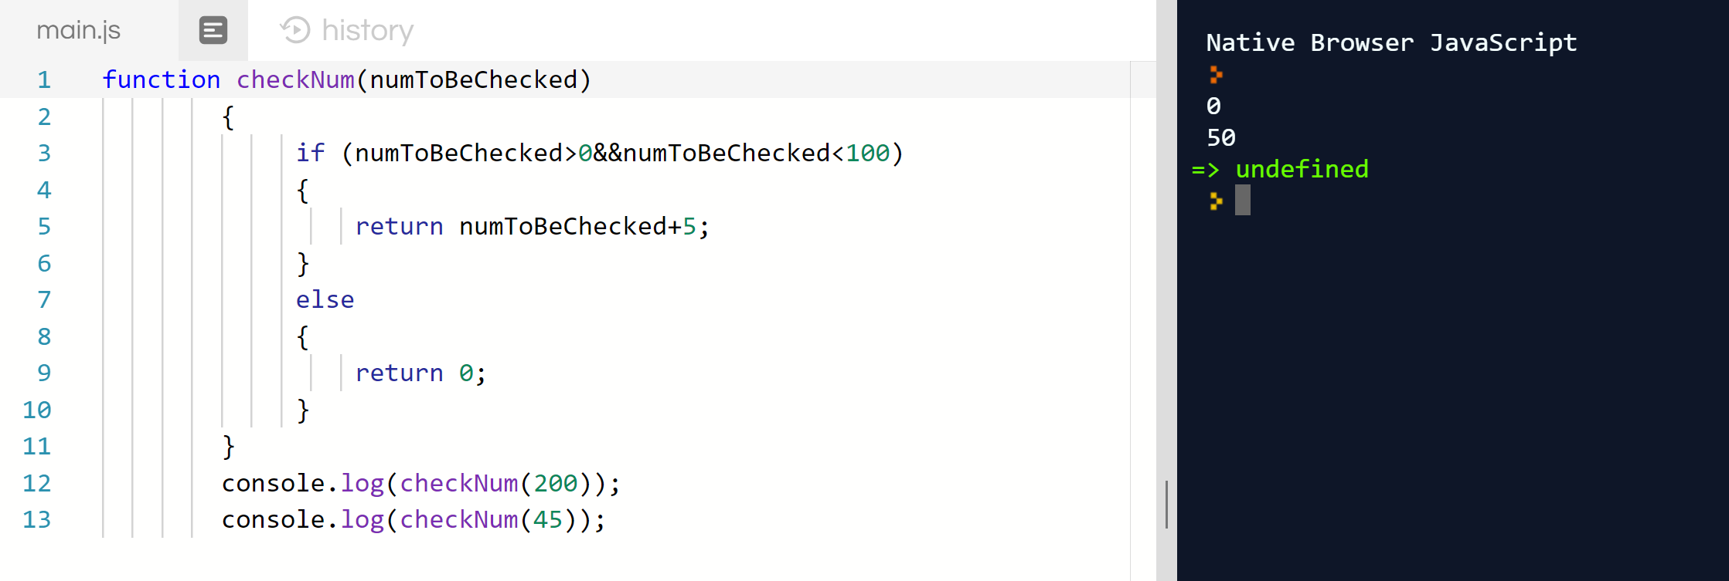
Answer for Javascript Exercise #2 Functions and Conditionals
Remember that there are more than one ways to code a solution to any problem. Here is one:

Slide 7
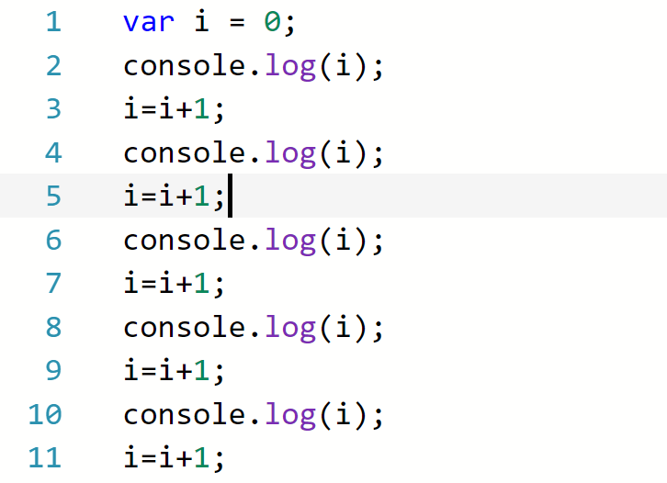
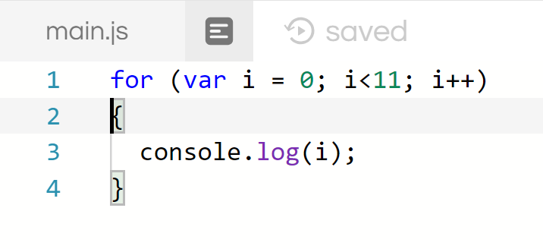
Exercise #3: Functions, Variables, Conditionals, and Loops
A last thing to practice is loops. Loops are a way to tell the computer: “I want you to do this set of instructions X amount of times”.
This is useful because instead of you copying and pasting the same code millions of times, the computer does the work for you.
Example: If you are wanting to print the numbers 1 through ten, what seems like a more easy way:
It goes on twice as much as shown

Slide 8
Final Exercise: Variables, Functions, Coditionals, and Loops
We will now write a Javascript function with all 4CoreConcepts!
Please write a Javascript Function that does the following:
Creates a variable of whatever name you want with value 5.
Make one loop that will run 10 times. In this loop, multiply your variable times 6 each time and print it with console.log
After being multiplied, check your variable to see if it is greater than 100. If it is, return 2000.
Remember: When your function returns a number, it breaks out of any function, loop, or conditional, no matter what!

Slide 9
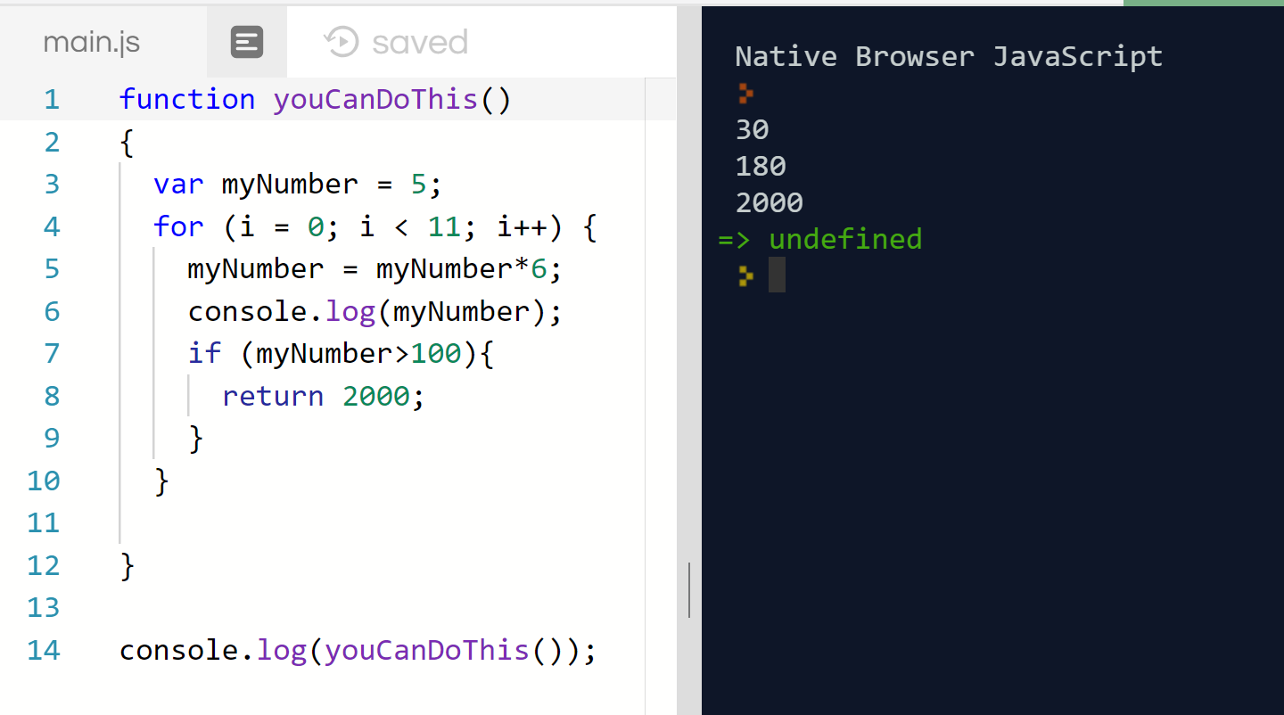
Final Exercise Answer: Variables, Functions, Conditionals, and Loops
Tip: If a problem seems overwhelming, break it into mini-problems and continue. You’ll solve it eventually!
Here’s one solution:

